Slide 1
Cancer Research in Australia: an overview of funding to cancer research projects and research programs in Australia 2006 to 2011
Evidence to inform research investment
Tables and Figures from the Report

Slide 2
Copyright Conditions
© Cancer Australia 2013
This work is copyright. You may reproduce the whole or part of this work in unaltered form for your own personal use or, if you are part of an organisation, for internal use within your organisation, but only if you or your organisation do not use the reproduction for any commercial purpose and retain this copyright notice and all disclaimer notices as part of that reproduction. Apart from rights to use as permitted by the Copyright Act 1968 or allowed by this copyright notice, all other rights are reserved and you are not allowed to reproduce the whole or any part of this work in any way (electronic or otherwise) without first being given the specific written permission from Cancer Australia to do so. Requests and inquiries concerning reproduction and rights are to be sent to the Publications and Copyright contact officer, Cancer Australia, Locked Bag 3, Strawberry Hills NSW 2012.

Slide 3
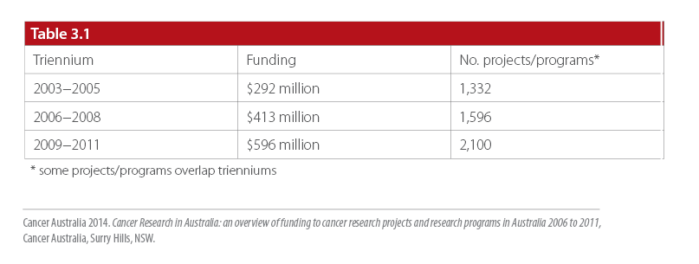
Table 3.1
Direct funding to and number of cancer research projects and research programs in Australia in 2003−2005, 2006−2008 and 2009−2011

Slide 4
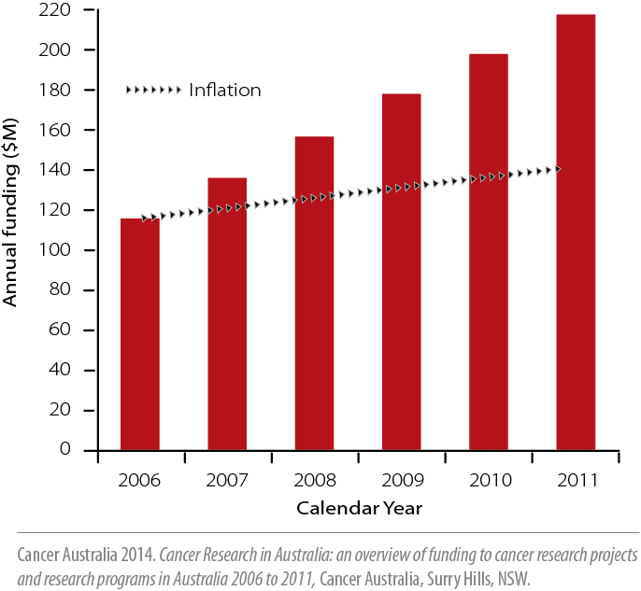
Figure 3.1
Annual direct funding to cancer research projects and
research programs in Australia, 2006 to 2011

Slide 5
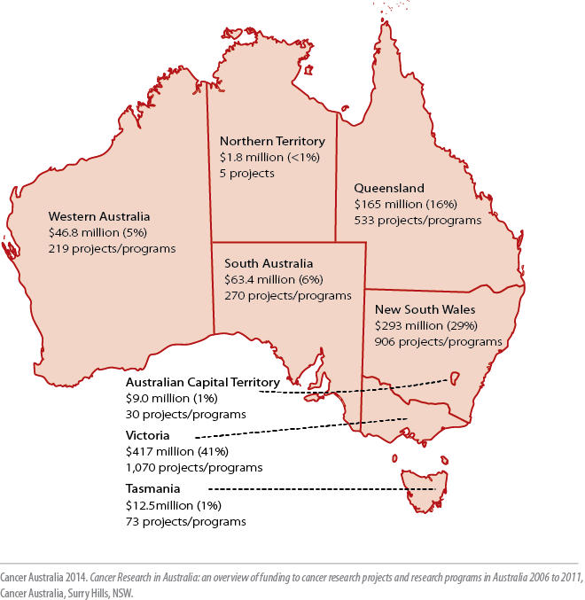
Figure 3.2
Distribution to states and territories of direct funding to cancer
research projects and research programs in Australia, 2006 to 2011

Slide 6
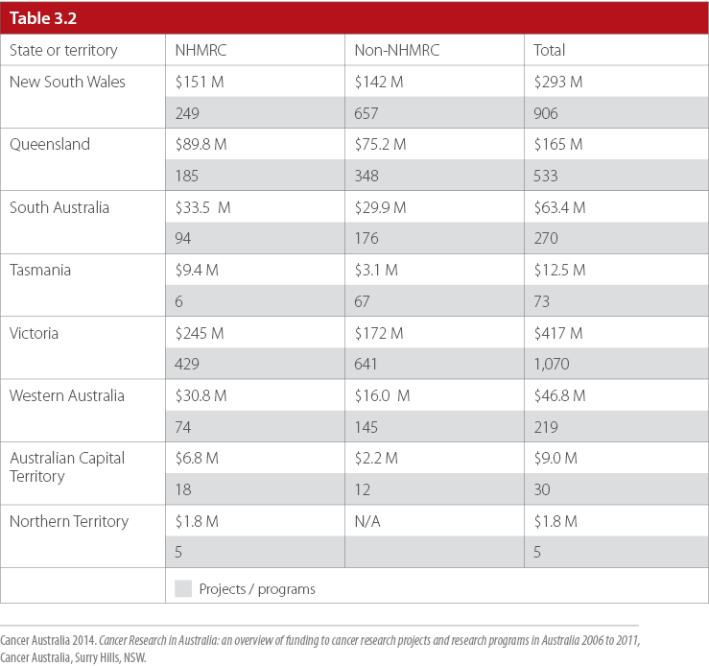
Table 3.2
Distribution to states and territories of direct funding to cancer research projects and research programs from NHMRC and non-NHMRC funding sources in the period 2006 to 2011

Slide 7
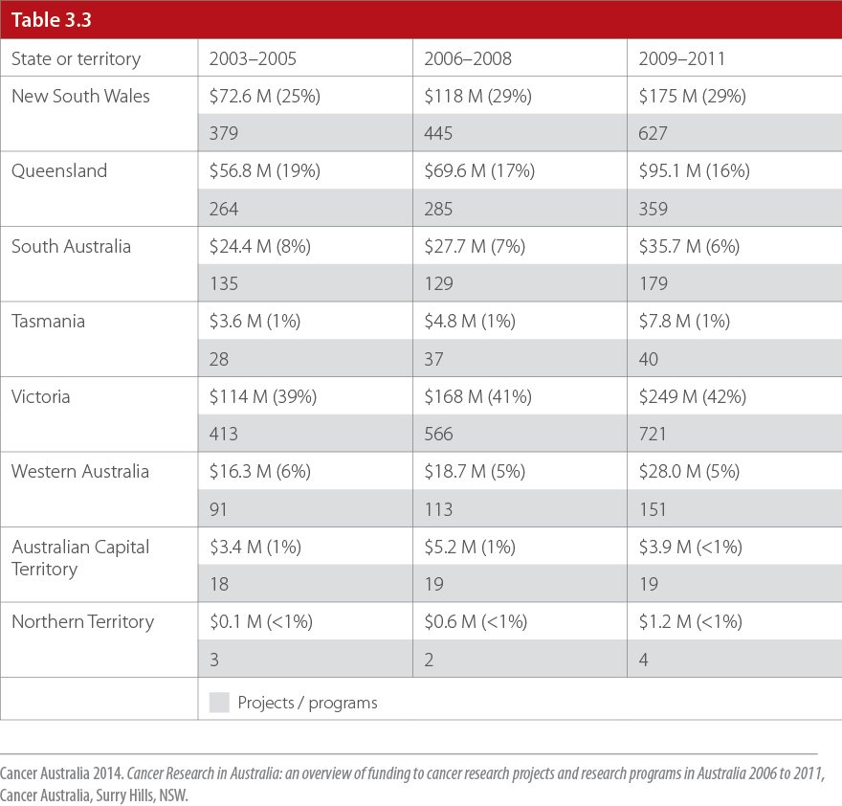
Table 3.3
Distribution to states and territories of direct funding to cancer research projects and research programs in 2003–2005, 2006–
2008 and 2009–2011

Slide 8
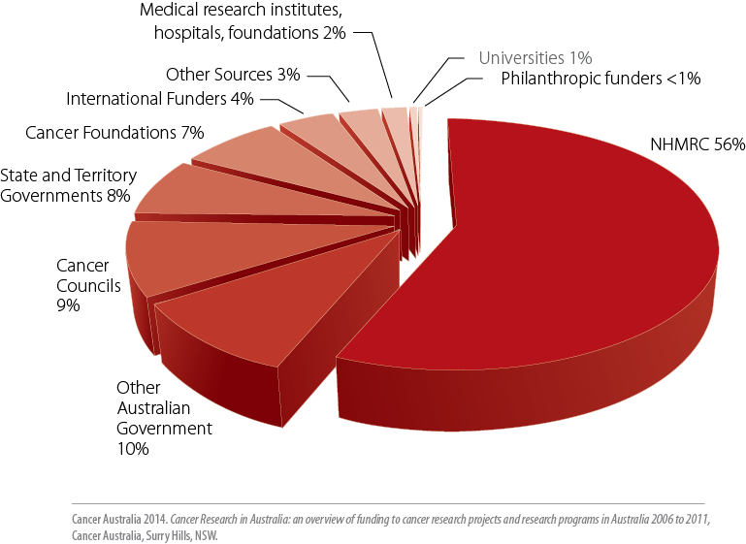
Figure 4.1
Proportion of funding to cancer research projects and research programs by funding source in the period 2006 to 2011

Slide 9
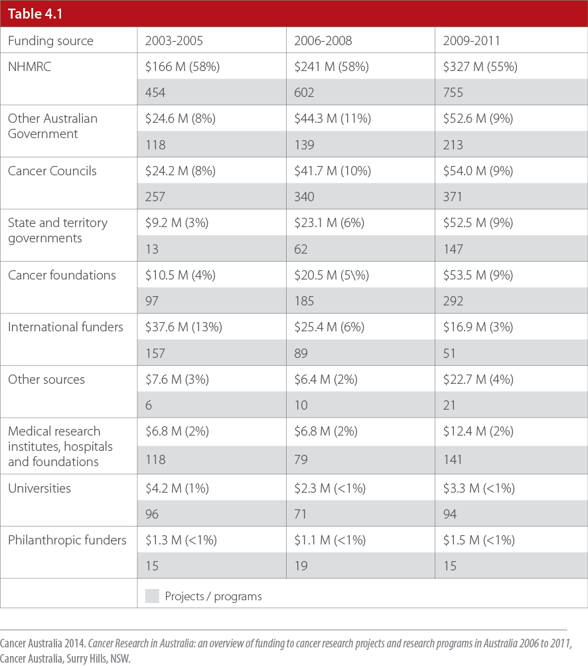
Table 4.1
Major sources of funding – total direct funding, percentage of total direct funding and number of cancer research projects and research programs funded in 2003−2005, 2006−2008 and 2009−2011

Slide 10
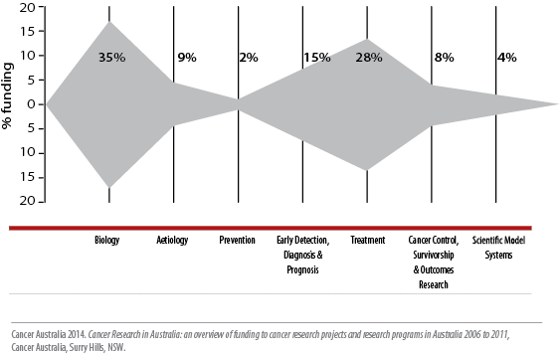
Figure 5.1
The pattern of funding to each CSO category and percentage of total direct funding to each CSO category in the period 2006 to 2011

Slide 11
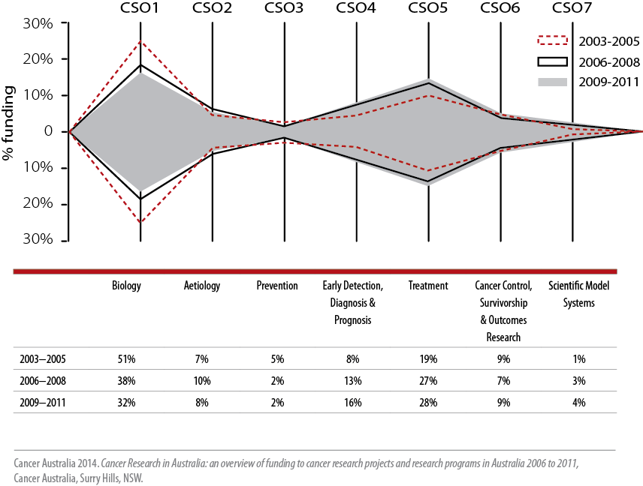
Figure 5.2
The pattern of funding to each CSO category and the percentage of proportional funding in 2003–2005, 2006–2008 and 2009–2011

Slide 12
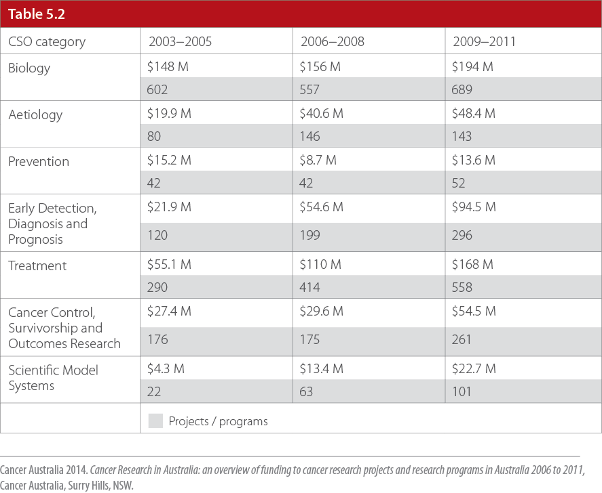
Table 5.2
Direct funding to and number of cancer research projects and research
programs in each CSO category in 2003−2005, 2006−2008 and 2009− 2011

Slide 13
Figure 5.3
The pattern of funding to each CSO category and the percentage of
proportional funding from the NHMRC in 2003−2005, 2006−2008 and
2009−2011

Slide 14
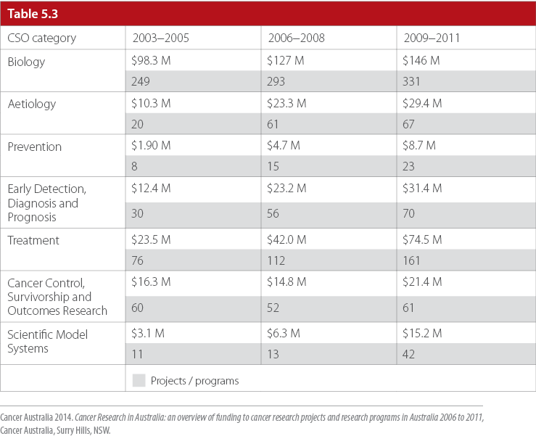
Table 5.3
Direct funding to and number of research projects and research programs funded by the NHMRC in 2003−2005, 2006−2008 and 2009−2011

Slide 15
Figure 5.4
The pattern of funding to each CSO category and the percentage of proportional funding from other (non-NHMRC) funding sources in 2003− 2005, 2006−2008 and 2009−2011

Slide 16
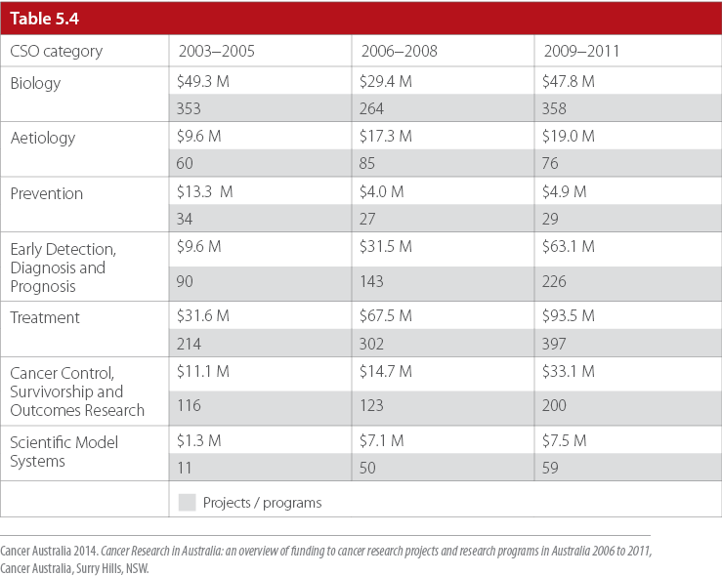
Table 5.4
Direct funding to and number of research projects and research programs in each CSO category funded by other (non-NHMRC) sources in 2003−2005, 2006−2008 and 2009−2011

Slide 17
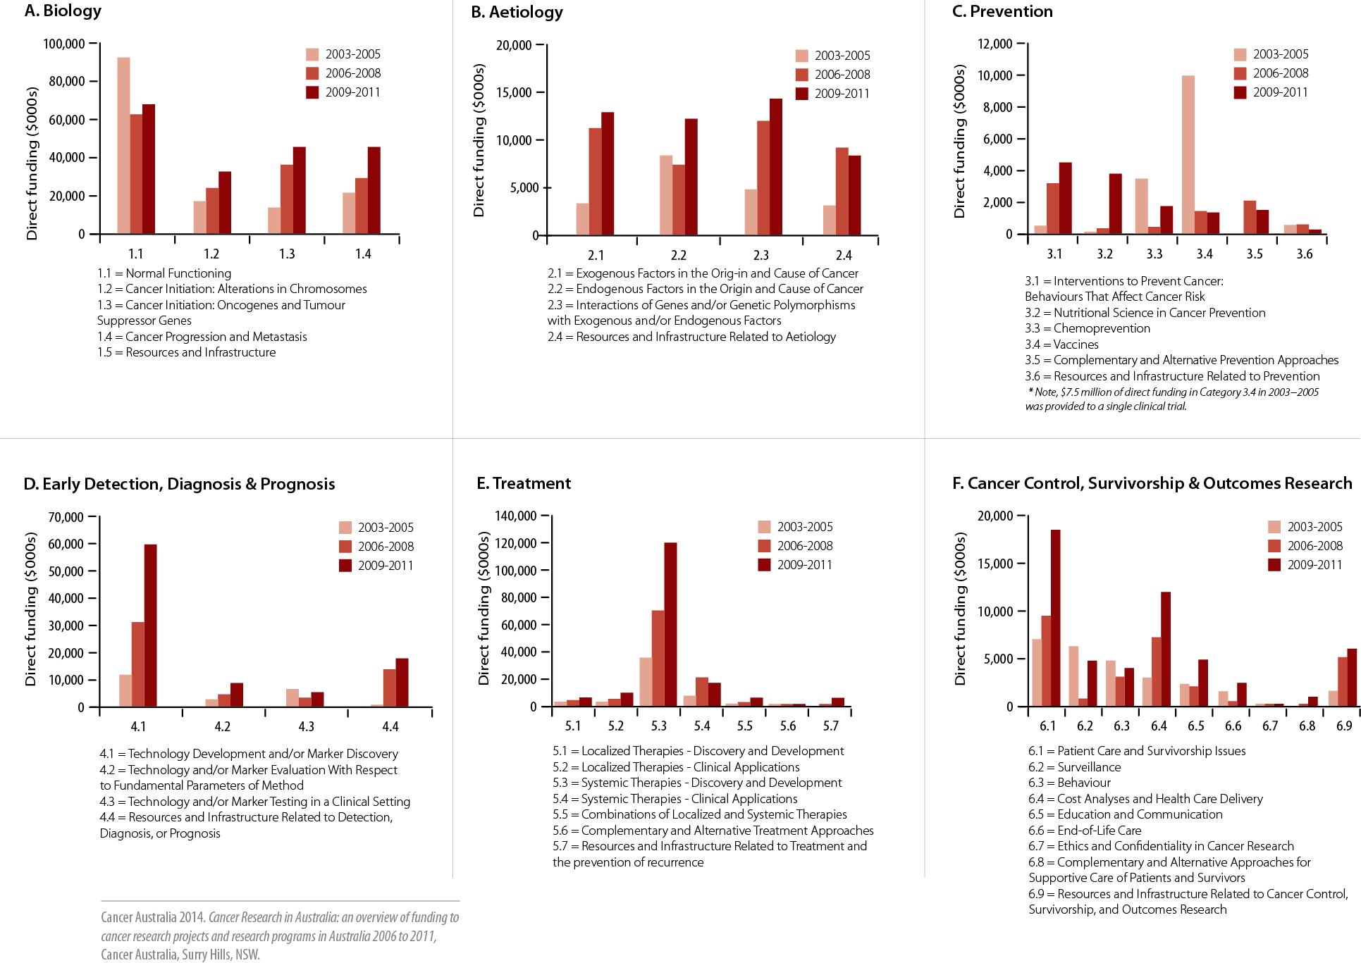
Figure 5.5
Pattern of direct funding to CSO sub-categories in 2003−2005, 2006−2008 and 2009−2011

Slide 18
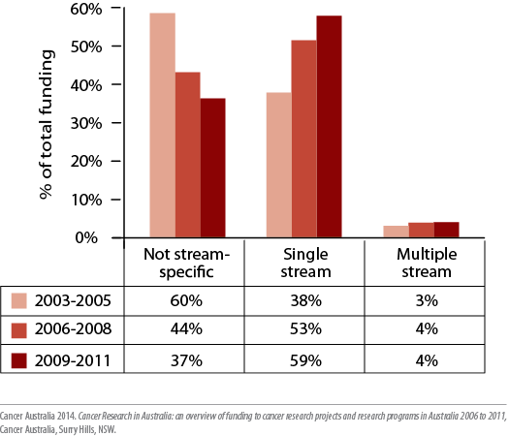
Figure 6.1
Proportional distribution of direct funding to Not tumour stream-specific, Single stream, or Multiple stream research categories in 2003−2005, 2006−2008 and 2009−2011

Slide 19
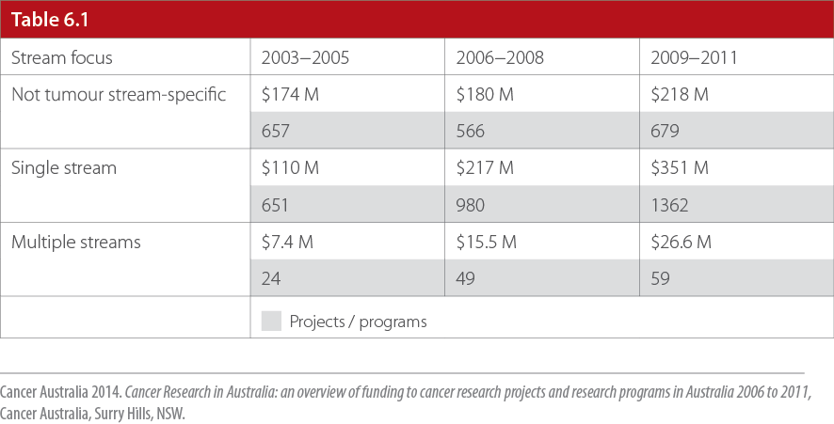
Table 6.1
Direct funding to and number of research projects and research programs in Not tumour stream-specific, Single stream or Multiple streams research in 2003–2005, 2006−2008 and 2009–2011

Slide 20
Figure 6.2A
The pattern of funding to each CSO category for research that was not
tumour stream-specific in 2003−2005, 2006−2008 and 2009−2011

Slide 21
Figure 6.2B
The pattern of funding to each CSO category for research that was not
tumour stream-specific in 2003−2005, 2006−2008 and 2009−2011

Slide 22
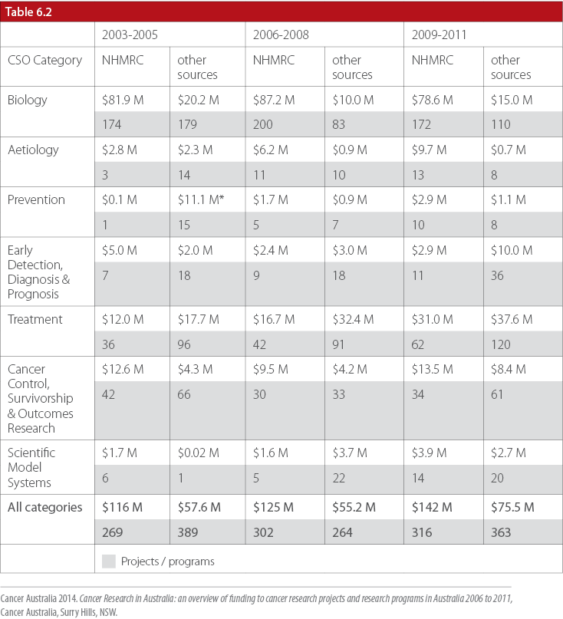
Table 6.2
Direct funding to and number of research projects and research programs in each CSO category for research that was not tumour stream-specific in 2003–2005, 2006–2008 and 2009–2011

Slide 23
Figure 6.3A
The pattern of funding to each CSO category for cancer research that was specific to a tumour stream(s) in 2003−2005, 2006−2008 and 2009−2011

Slide 24
Figure 6.3B
The pattern of funding to each CSO category for cancer research that was specific to a tumour stream(s) in 2003−2005, 2006−2008 and 2009−2011

Slide 25
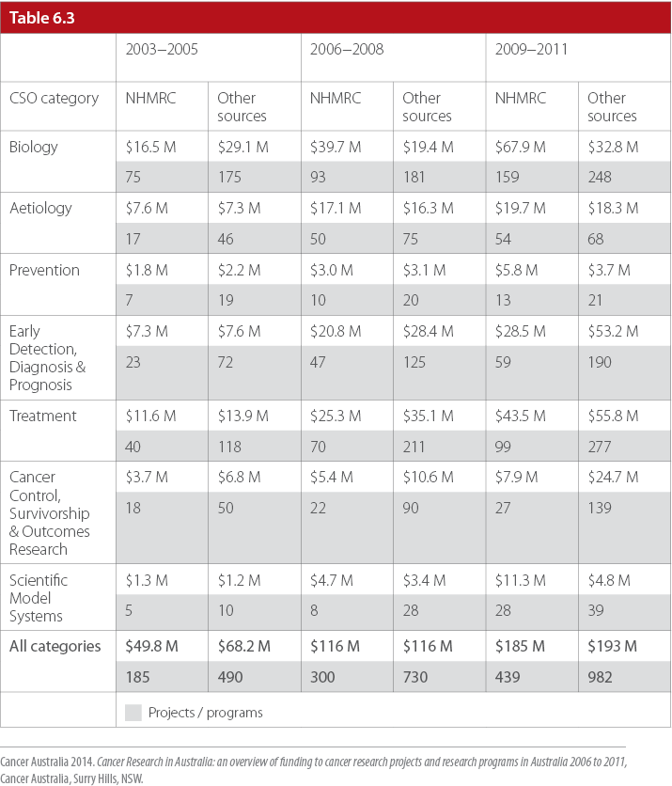
Table 6.3
Direct funding to and number of research projects and research programs in each CSO category for research that was specific to single or multiple tumour stream(s) in 2003−2005, 2006−2008 and 2009−2011

Slide 26
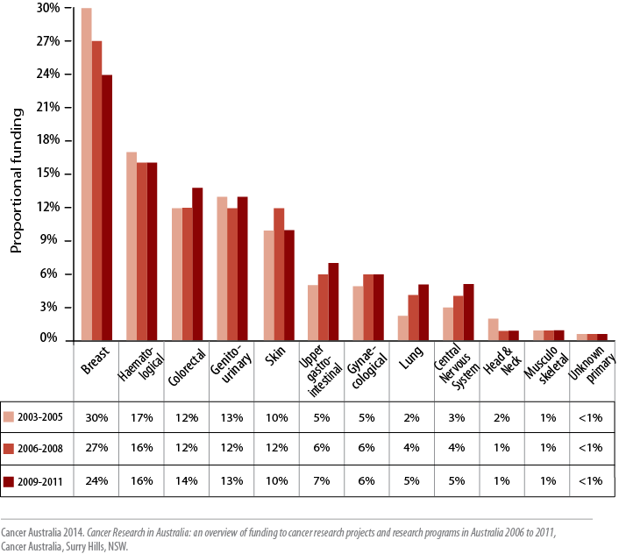
Figure 7.1
Proportional funding to single tumour stream cancer research projects and research programs in 2003–2005, 2006–2008 and 2009–2011

Slide 27
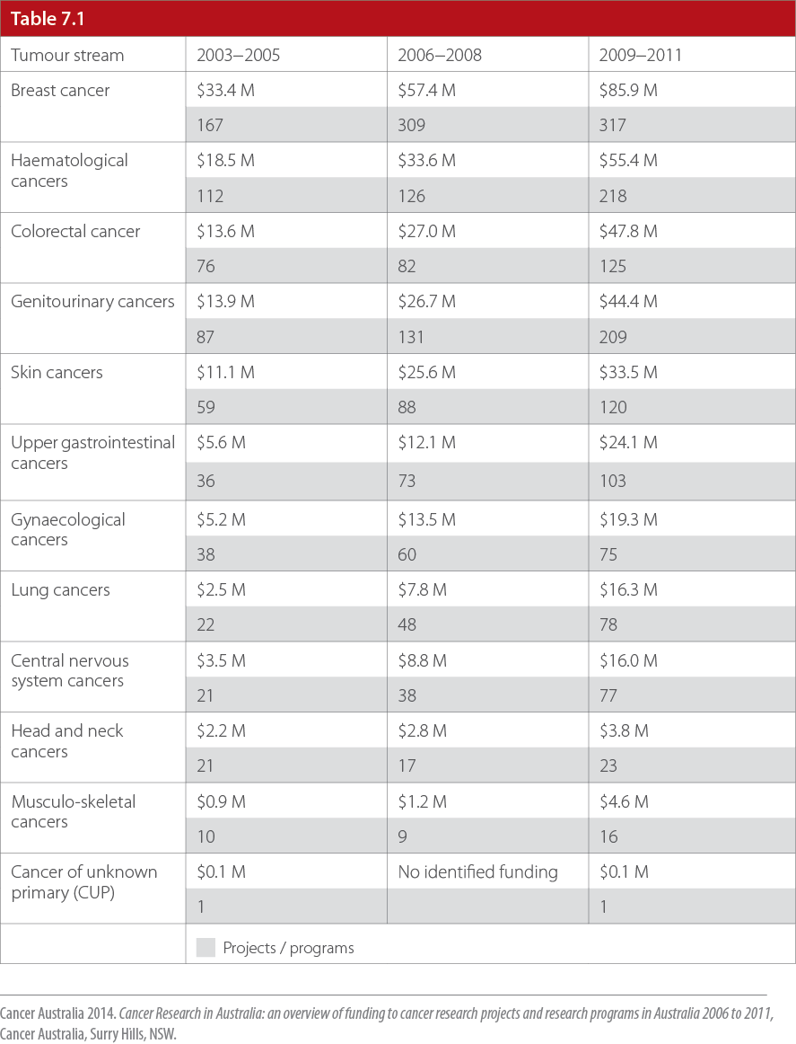
Table 7.1
Proportional funding to single tumour stream cancer research projects and research programs in 2003–2005, 2006–2008 and 2009–2011

Slide 28
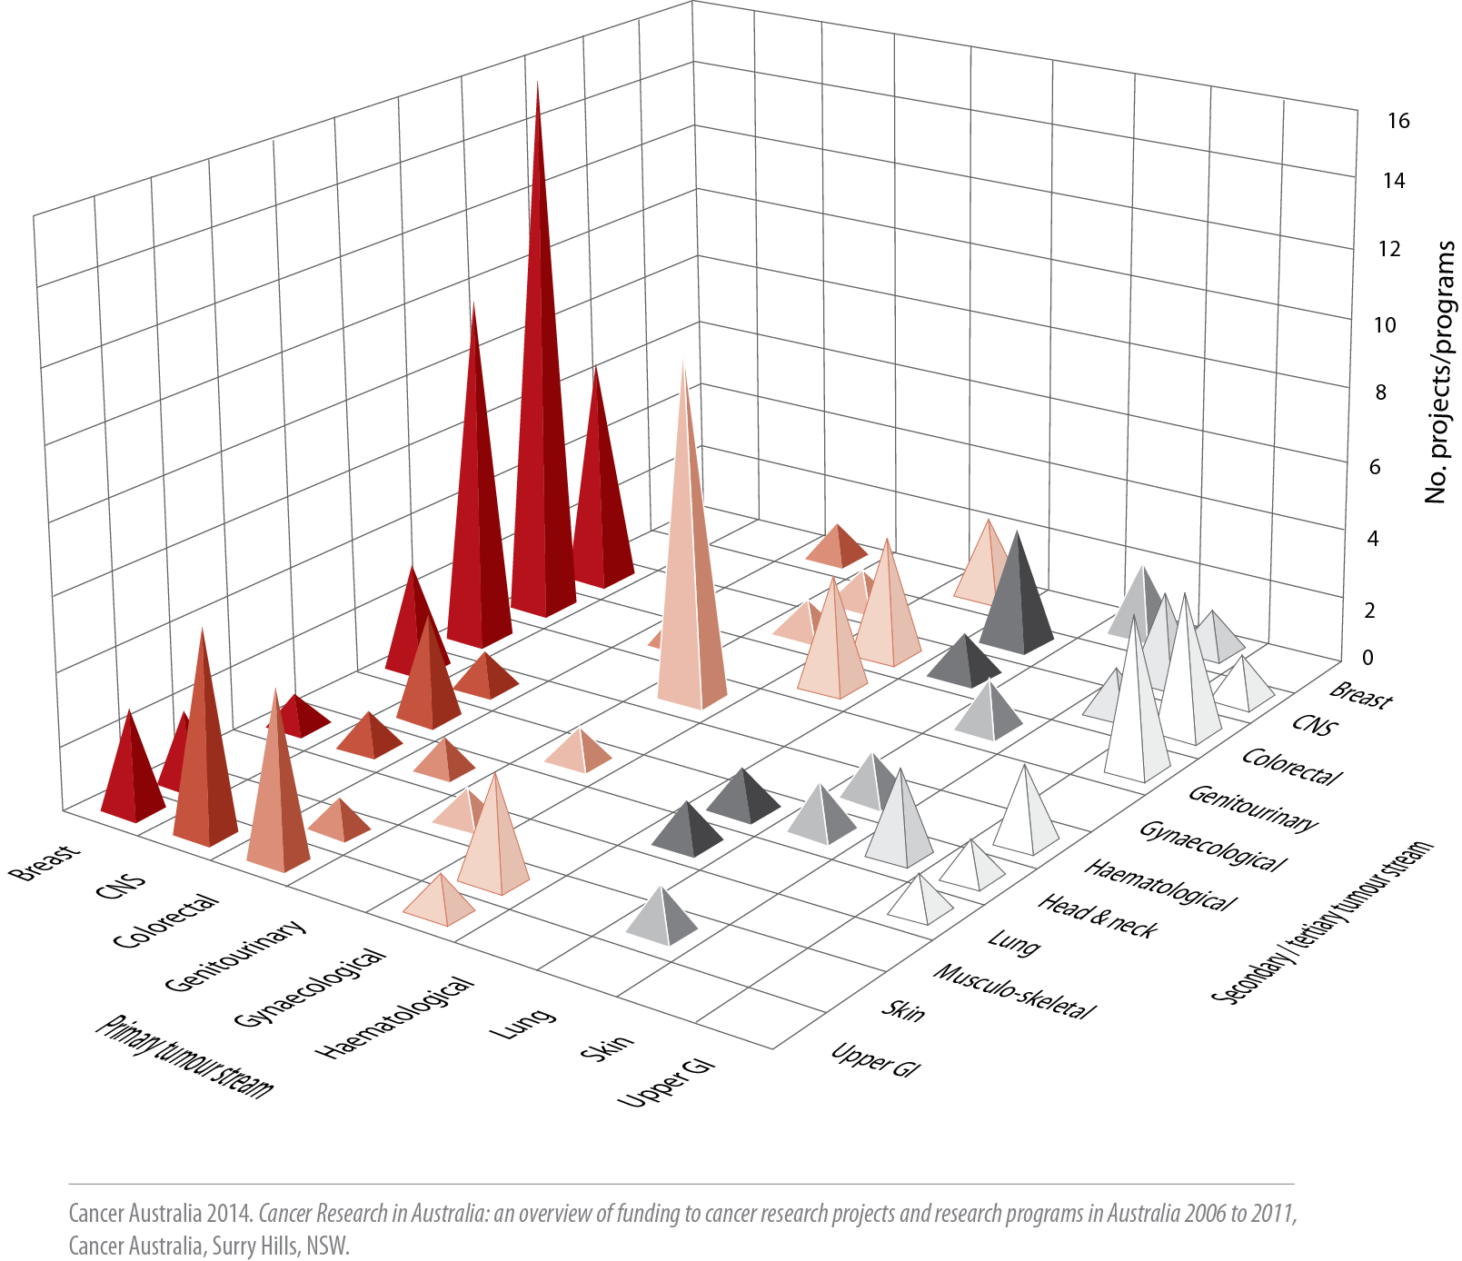
Figure 7.2
Tumour stream combinations in multiple tumour stream research projects and research programs in the period 2006 to 2011

Slide 29
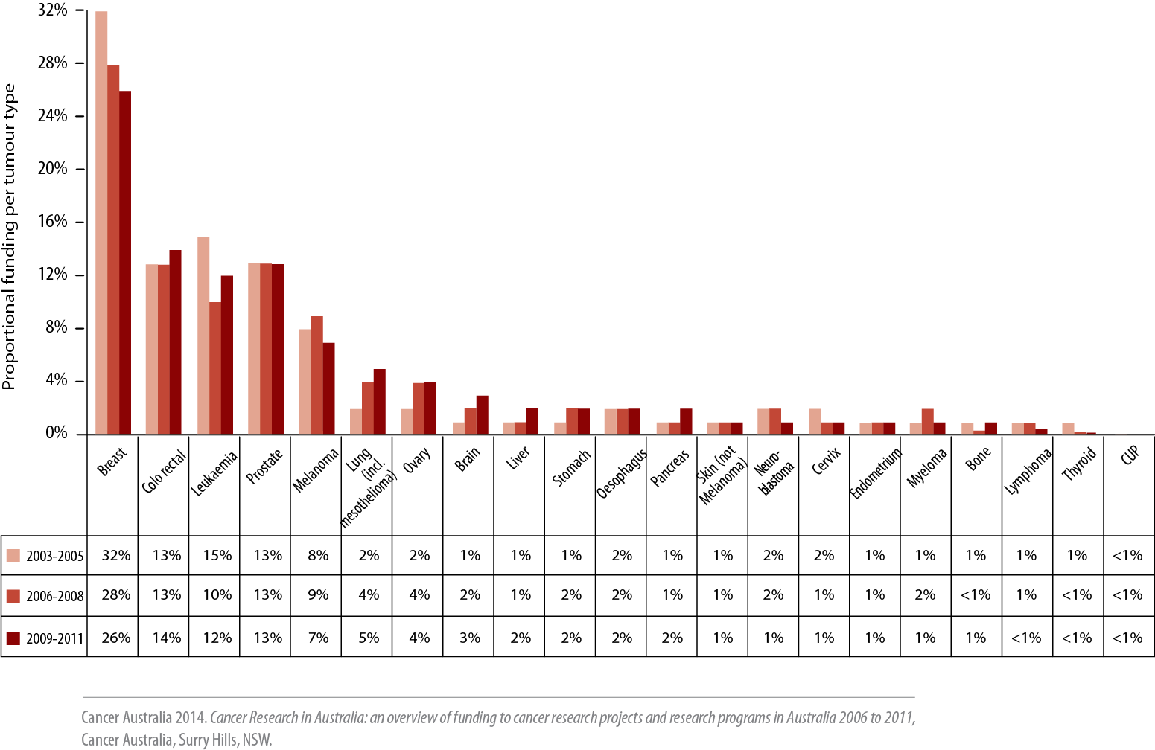
Figure 8.1
Proportional funding to single tumour type cancer research projects and research programs in 2003–2005, 2006–2008 and 2009–2011

Slide 30
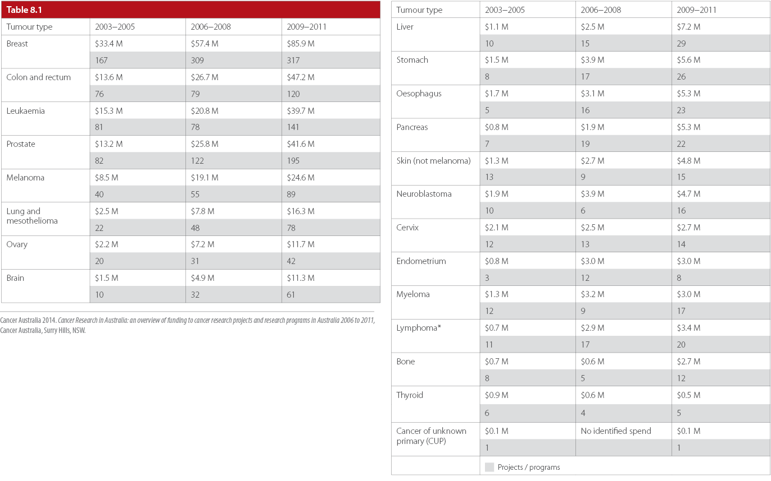
Table 8.1
Direct funding to and number of single tumour type research projects and research programs in 2003−2005, 2006−2008 and 2009−2011

Slide 31
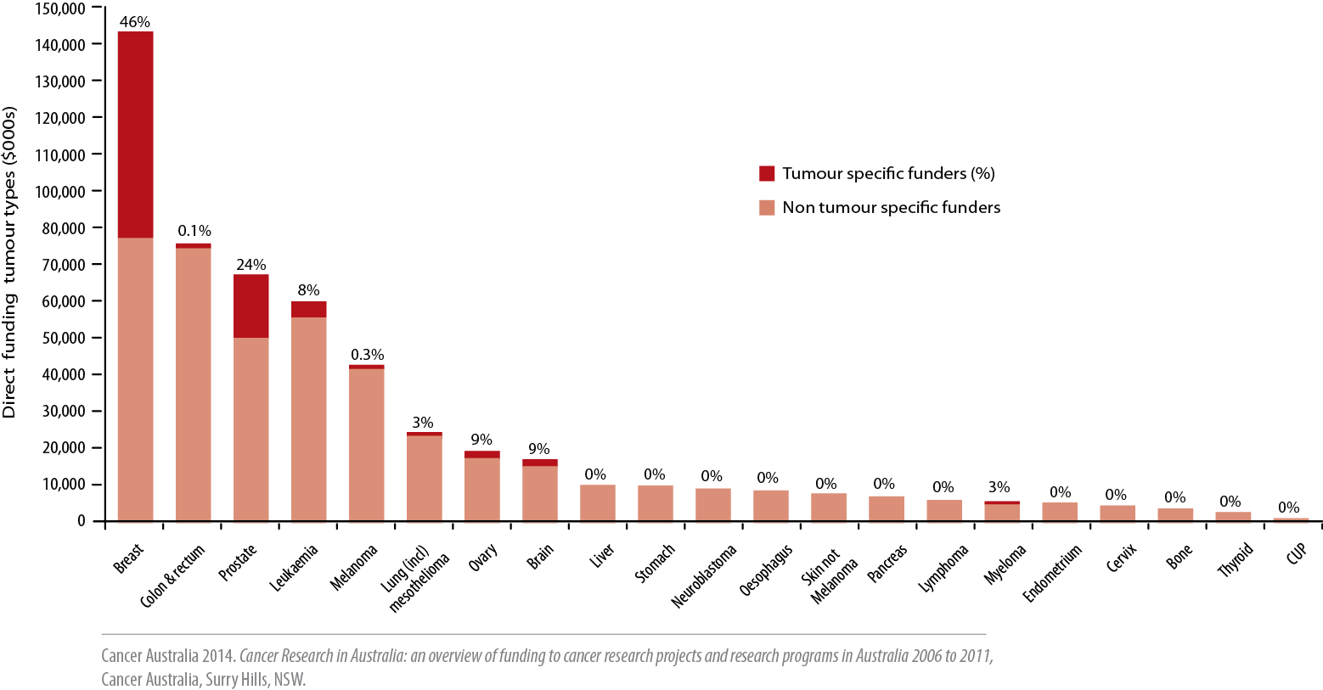
Figure 8.2
Direct and proportional funding contribution by tumour type-specific funders and non tumour type-specific funders to direct funding to tumour type-specific cancer research projects and research programs in the period 2006 to 2011

Slide 32
Figure 8.3
Direct funding to tumour type-specific cancer research projects and research programs in Australia 2006 to 2011, compared with the top 20 cancers by incidence in Australia, 2009

Slide 33
Figure 8.4
Direct funding to tumour type-specific cancer research projects and research programs in Australia 2006 to 2011, compared with the top 20 cancers by mortality in Australia, 2010

Slide 34
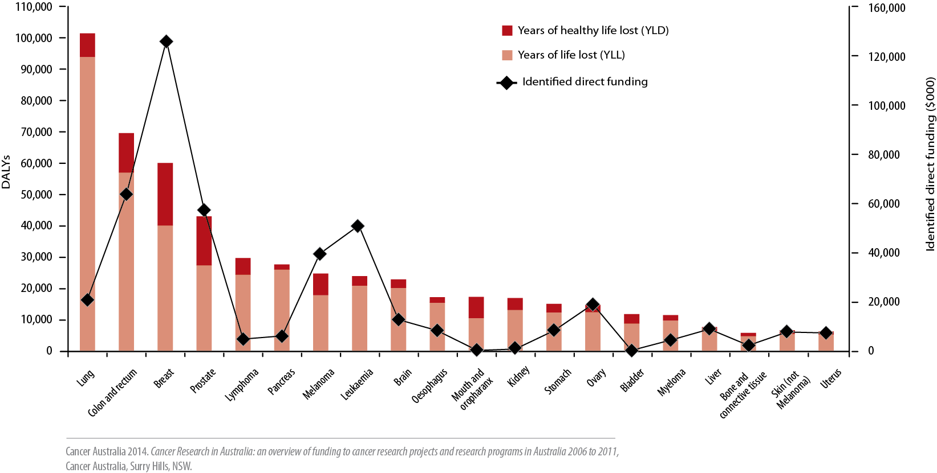
Figure 8.5
Direct funding to single tumour type-specific cancer research projects and research programs in Australia 2006 to 2011, compared with the top 20 cancers by DALYs in Australia, 2012

Slide 35
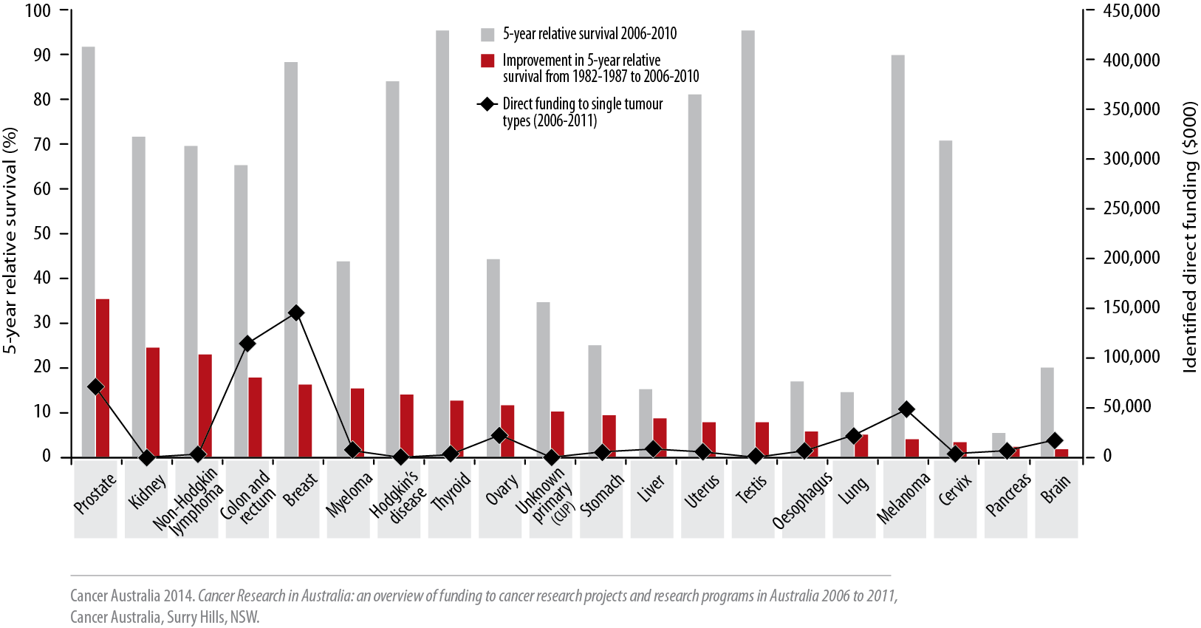
Figure 8.6
Direct funding to single tumour type-specific cancer research projects and research programs in Australia (2006–2011), compared with the improvement in 5-year relative survival since 1982-1987 and the overall 5-year relative survival (2006−2010) for selected cancers

Slide 36
Figure 9.1
Breast cancer research projects and research programs: pattern of proportional
funding to each CSO category in 2003−2005, 2006−2008 and 2009−2011

Slide 37
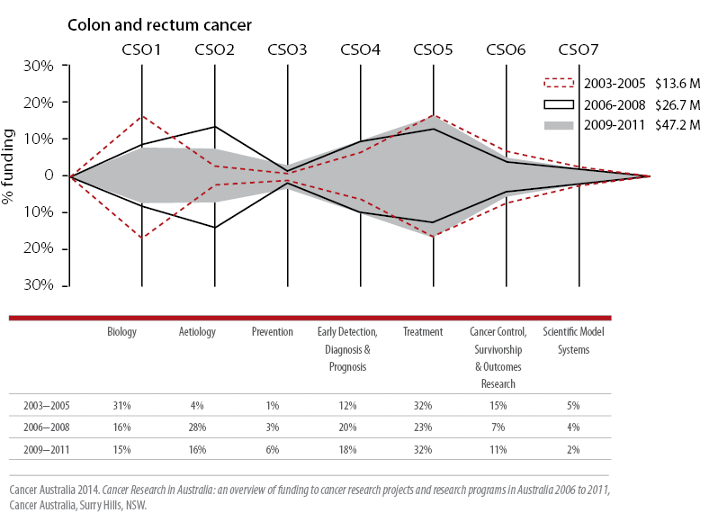
Figure 9.2
Colon and rectum cancer research projects and research programs: pattern of proportional funding to each CSO category in 2003−2005, 2006−2008 and 2009−2011

Slide 38
Figure 9.3
Prostate cancer research projects and research programs: pattern of proportional funding to each CSO category in 2003−2005, 2006−2008 and 2009−2011

Slide 39
Figure 9.4
Leukaemia research projects and research programs: pattern of proportional funding to each CSO category in 2003−2005, 2006−2008 and 2009−2011

Slide 40
Figure 9.5
Melanoma research projects and research programs: pattern of proportional funding to each CSO category in 2003−2005, 2006−2008 and 2009−2011

Slide 41
Figure 9.6
Lung cancer and mesothelioma research projects and research programs: pattern of proportional funding to each CSO category in 2003−2005, 2006− 2008 and 2009−2011

Slide 42
Figure 9.7
Gynaecological cancer research projects and research programs: pattern of proportional funding to each CSO category in 2003−2005, 2006−2008 and 2009−2011

Slide 43
Figure 9.8
Ovarian cancer research projects and research programs: pattern of
proportional funding to each CSO category in 2003−2005, 2006−2008 and 2009−2011

Slide 44
Figure 9.9
Cervical cancer research projects and research programs: pattern of
proportional funding to each CSO category in 2003−2005, 2006−2008 and 2009−2011

Slide 45
Figure 9.10
Endometrial cancer research projects and research programs: pattern of
proportional funding to each CSO category in 2003−2005, 2006−2008 and 2009−2011

Slide 46
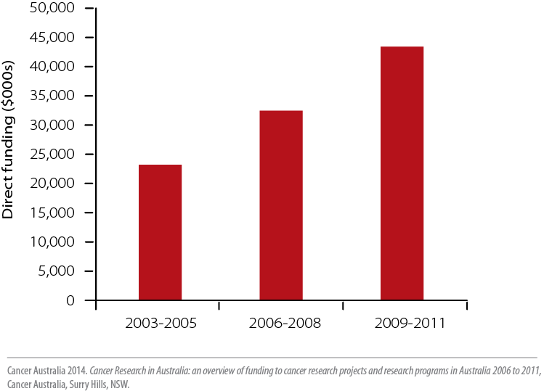
Figure 10.1
Direct funding to and number of cancer clinical trial research projects and research programs in 2003−2005, 2006−2008 and 2009−2011

Slide 47
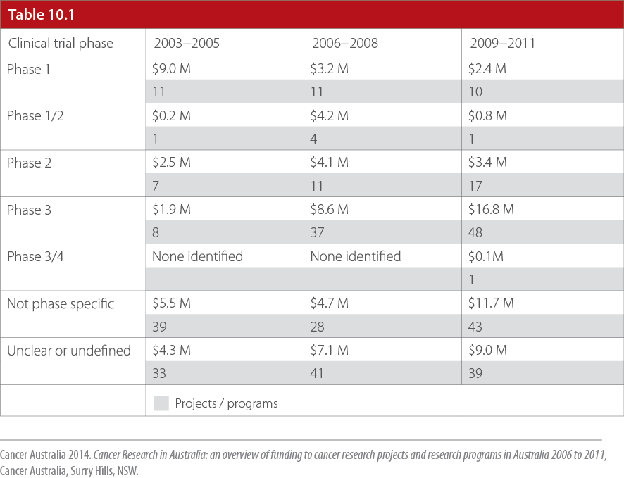
Table 10.1
Direct funding to and number of cancer clinical trial research projects and research programs in 2003−2005, 2006−2008 and 2009−2011

Slide 48
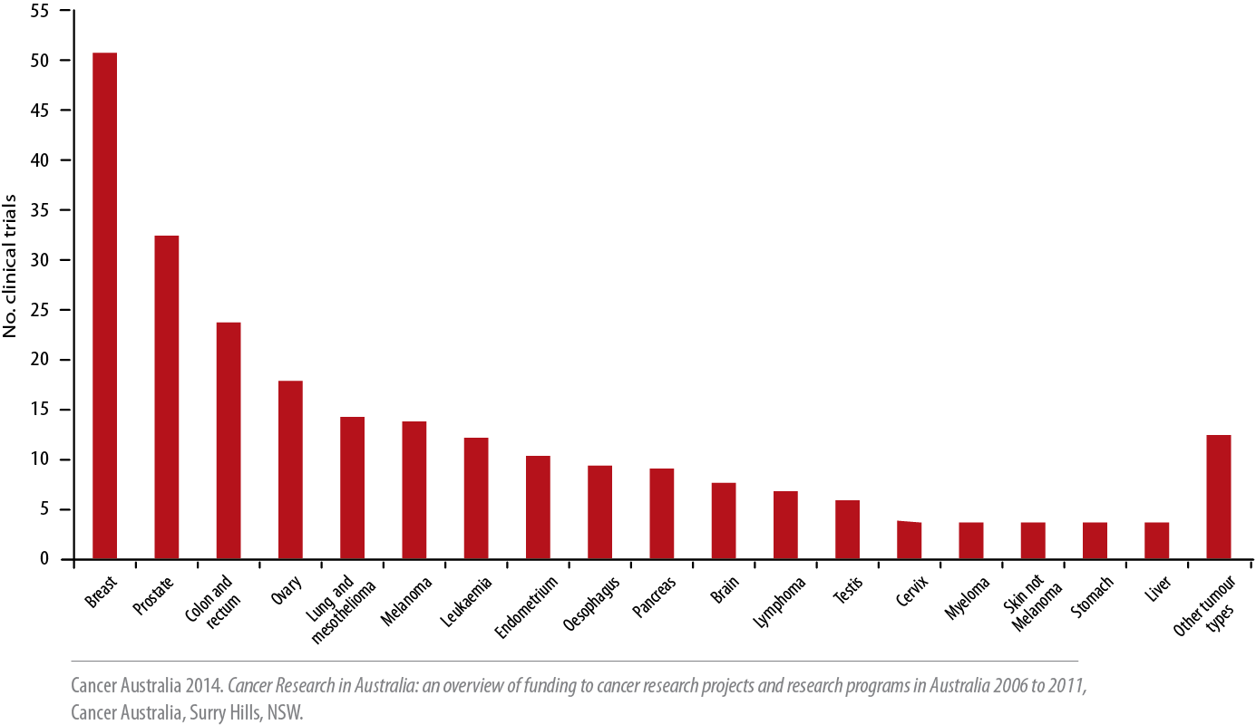
Figure 10.2
The number of cancer clinical trials with a specific tumour type focus in the period 2006 to 2011

Slide 49
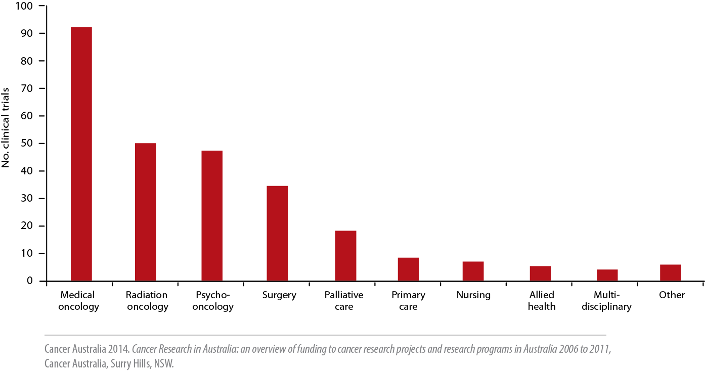
Figure 10.3
The number of cancer clinical trials with a health discipline focus in the period 2006 to 2011

Slide 50
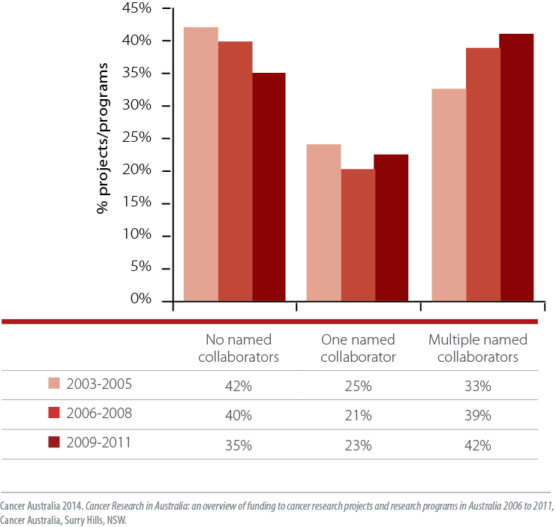
Figure 11.1
The proportion of cancer research projects and research
programs in each collaboration category in 2003−2005,
2006−2008 and 2009−2011

Slide 51
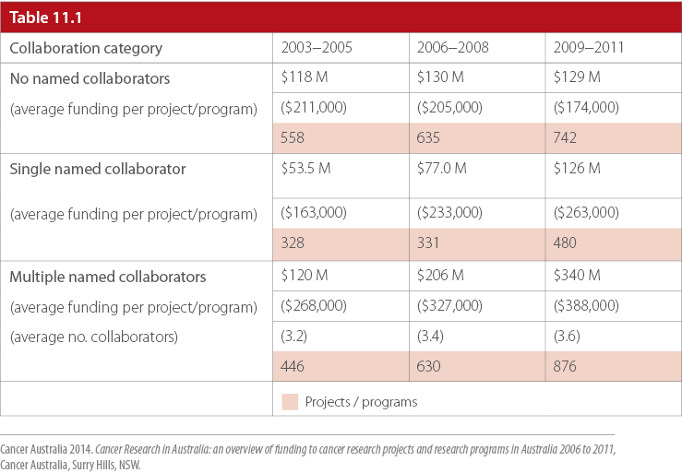
Table 11.1
Direct funding to and number of cancer research projects and research
programs, and average funding per project/program, in each collaboration category in 2003−2005, 2006−2008 and 2009−2011

Slide 52
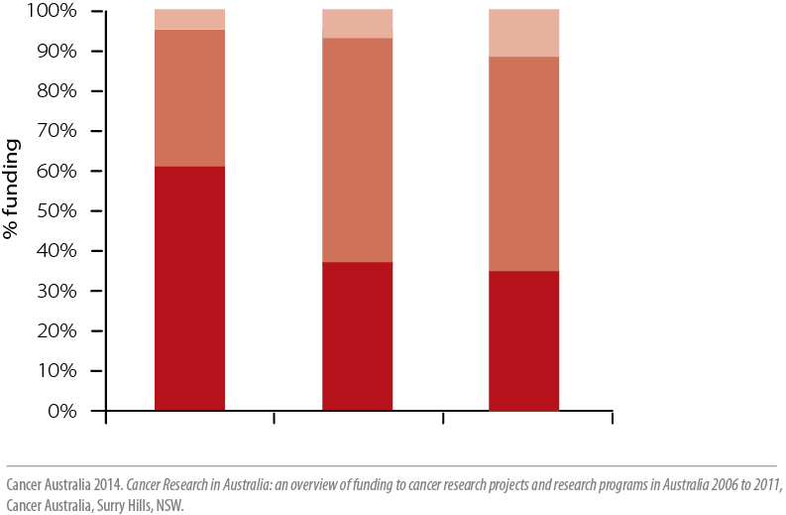
Figure 11.2
The proportional split of direct funding to cancer research projects and
research programs in each collaboration category in the period 2006 to 2011

Slide 53
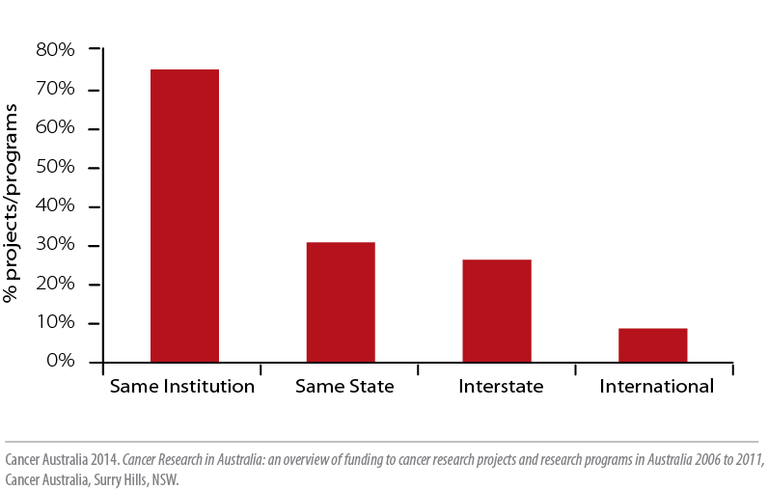
Figure 11.3
The proportion of cancer research projects and research programs in each collaboration location category in the period 2006 to 2011

Slide 54
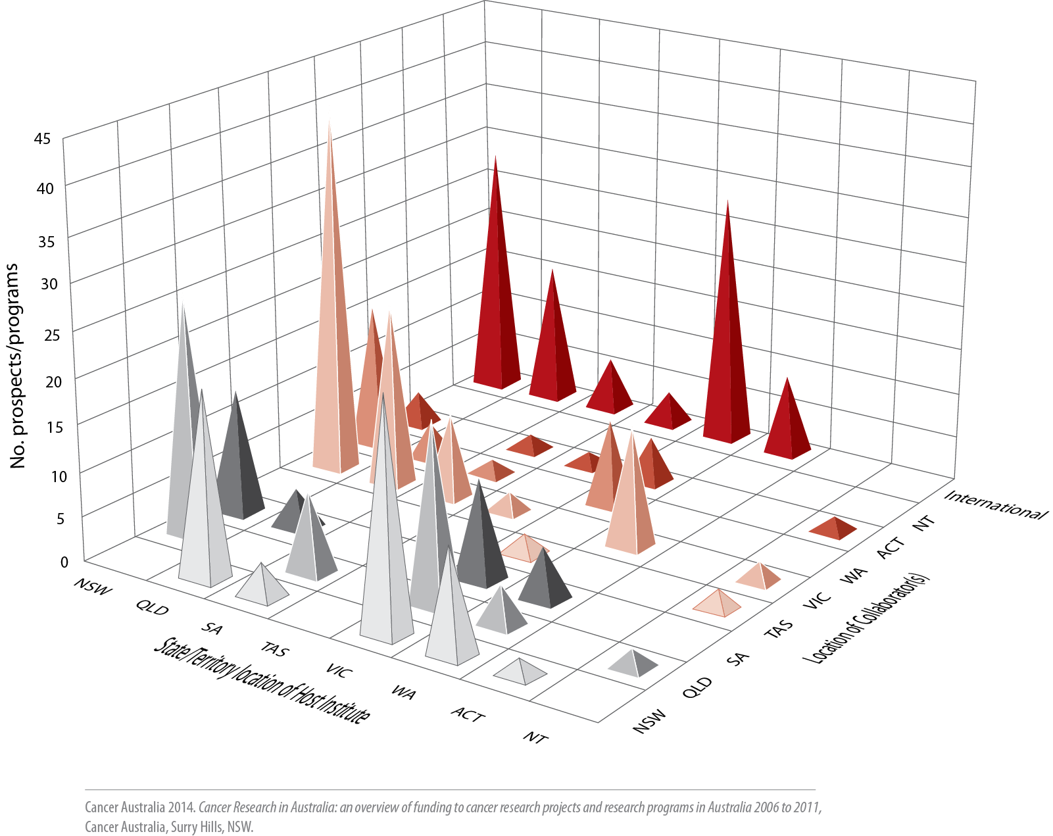
Figure 11.4
Interstate and international collaborations: number of cancer research
projects and research programs and location of collaborator(s) in the period 2006 to 2011

Slide 55
Figure 12.1
Cancer research projects and research programs in NSW: pattern of
proportional funding to each CSO category in 2003−2005, 2006−2008 and 2009−2011

Slide 56
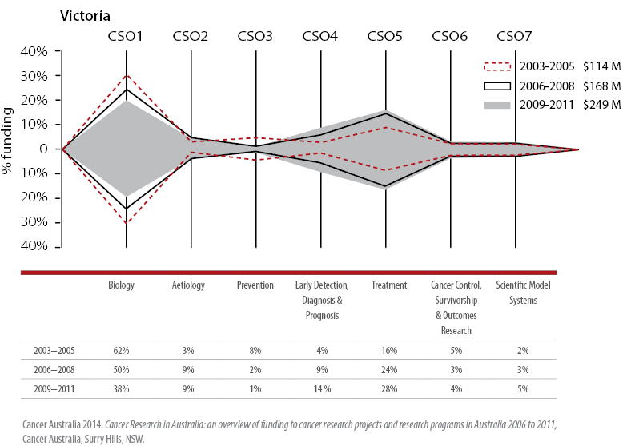
Figure 12.2
Cancer research projects and research programs in Victoria: pattern of
proportional funding to each CSO category in 2003−2005, 2006−2008 and 2009−2011

Slide 57
Figure 12.3
Cancer research projects and research programs in Queensland: pattern of proportional funding to each CSO category in 2003−2005, 2006−2008 and 2009−2011

Slide 58
Figure 12.4
Cancer research projects and research programs in South Australia: pattern of proportional funding to each CSO category in 2003−2005, 2006−2008 and 2009−2011

Slide 59
Figure 12.5
Cancer research projects and research programs in Western Australia: pattern of proportional funding to each CSO category in 2003−2005, 2006−2008 and 2009−2011

Slide 60
Figure 12.6 ACT
Cancer research projects and research programs in Australian Capital Territory: pattern of proportional funding to each CSO category in 2003− 2005, 2006−2008 and 2009−2011

Slide 61
Figure 12.6 NT
Cancer research projects and research programs in Northern Territory: pattern of proportional funding to each CSO category in 2003−2005, 2006−2008 and 2009−2011

Slide 62
Figure 12.6 Tasmania
Cancer research projects and research programs in Tasmania: pattern of proportional funding to each CSO category in 2003−2005, 2006−2008 and 2009−2011

Slide 63
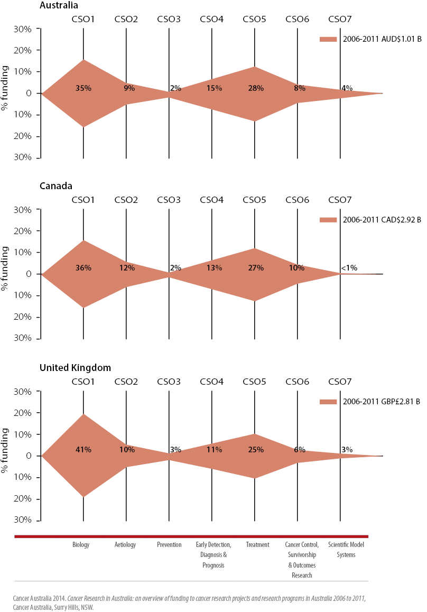
Figure 12.7
Comparison of the pattern of funding to cancer research in
Australia with Canada and the United Kingdom (2006–2011)

Slide 64
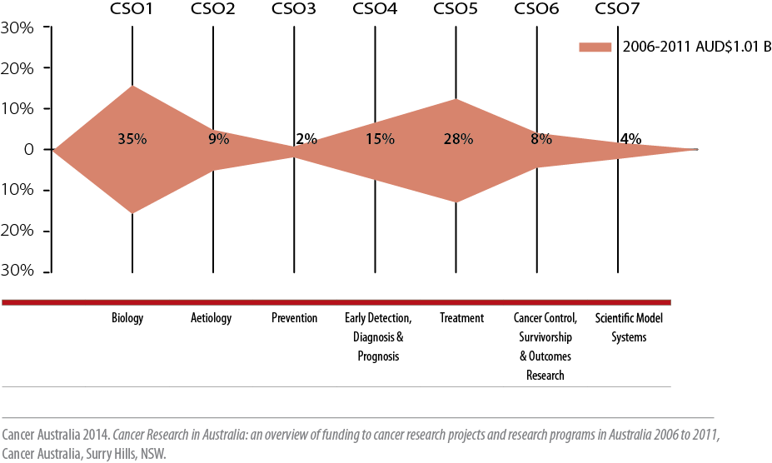
Figure 12.7 Australia
Pattern of funding to cancer research in Australia (2006–2011)

Slide 65
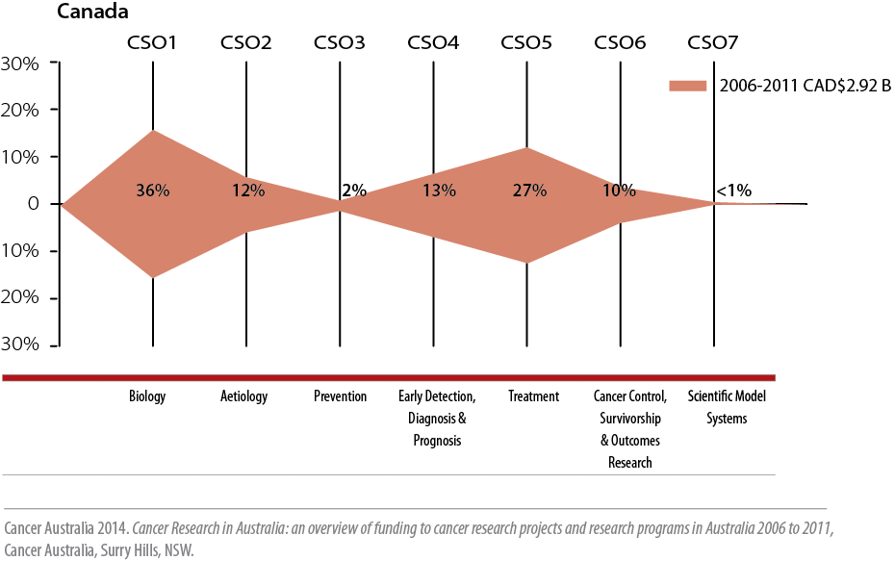
Figure 12.7 Canada
Pattern of funding to cancer research in Canada (2006–2011)

Slide 66
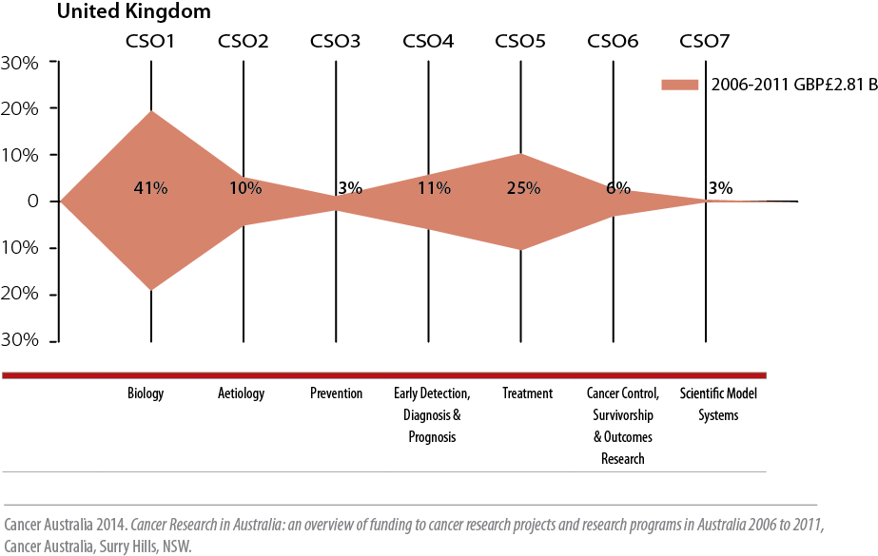
Figure 12.7 United Kingdom
Pattern of funding to cancer research in United Kingdom (2006–2011)

Slide 67
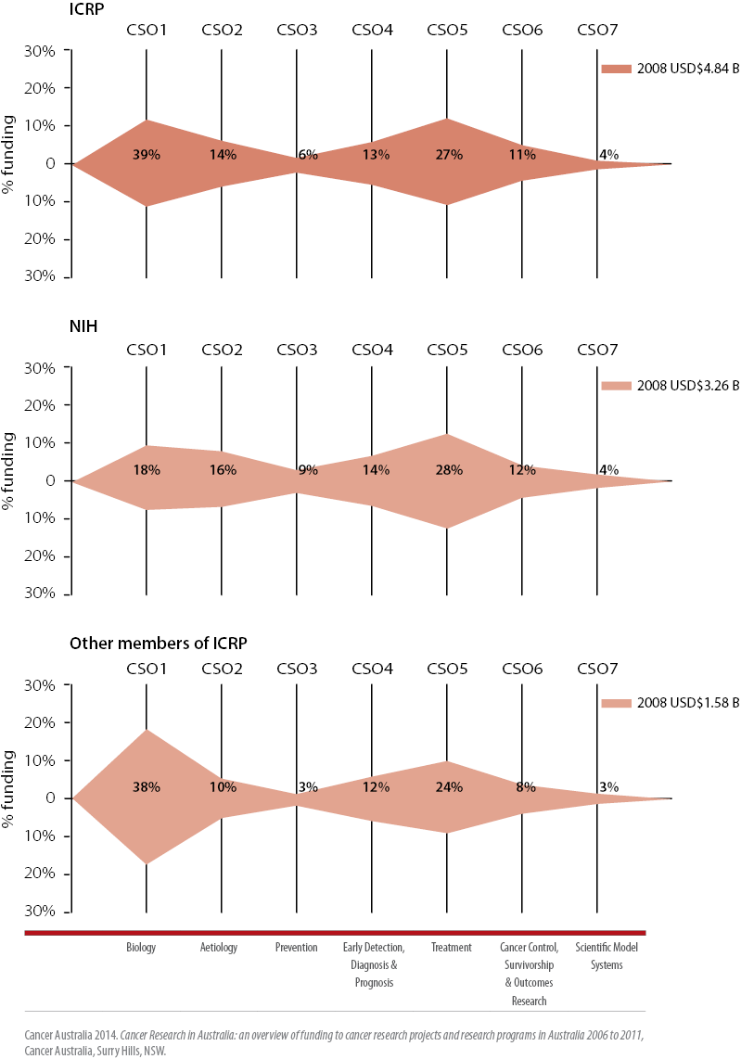
Figure 12.8
Pattern of funding in international cancer research (2008)

Slide 68
Figure 12.9 Australia
International comparisons of the changes in the patterns of funding to cancer research

Slide 69
Figure 12.9 United Kingdom
International comparisons of the changes in the patterns of funding to cancer research

Slide 70
Figure 12.9 Canada
International comparisons of the changes in the patterns of funding to cancer research

Slide 71
Figure 12.9 ICRP (inc. NIH)
International comparisons of the changes in the patterns of funding to cancer research

Slide 72
Figure 12.9 ICRP (NIH only)
International comparisons of the changes in the patterns of funding to cancer research

Slide 73
Figure 12.9 ICRP (members not including NIH)
International comparisons of the changes in the patterns of funding to cancer research

